Slide 1
Fedex Cargo Plane
David Charland, Omar Hassan, Sana Noor, Reuben O’Neill

Slide 2
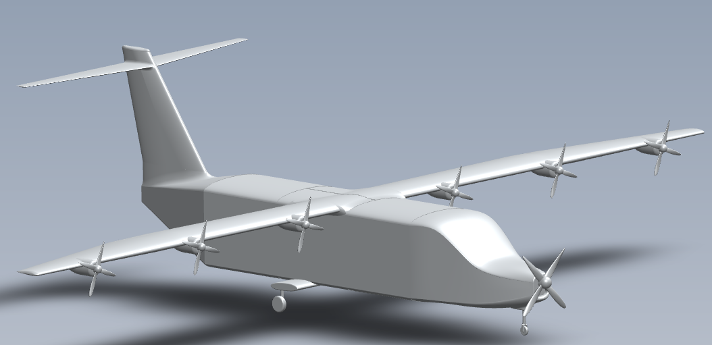
Our Plane

Slide 3
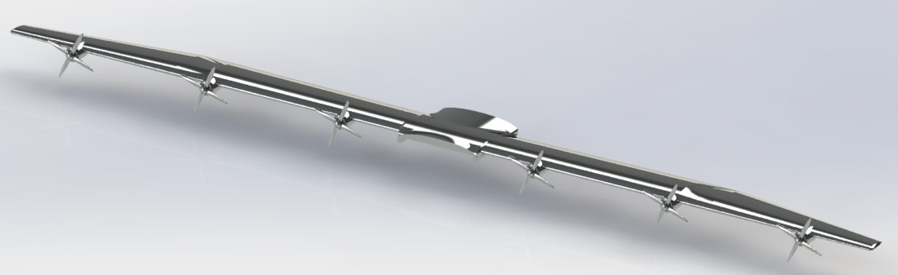
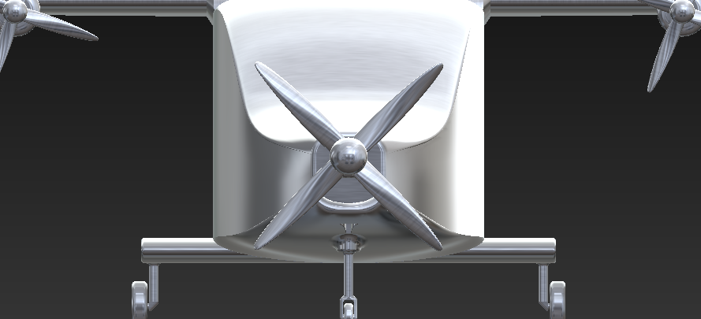
Green technology incorperations
Electric motors on wings
Hydrocarbon for cruise (Optimized for cruise)
Evenly distributed thrust
Motors evenly spaced along the leading edge

Slide 4


Modular battery packs
Allows for quick turnaround time
Reduce cost (smaller battery packs can be replaced more easily at a lower cost compared to to large)
Better weight distribution on the aircraft
Aircraft can easily adjust power used depending on payload and range
Airports will be able to have battery packs on the ground
Bottom of fuselage under the wing

Slide 5
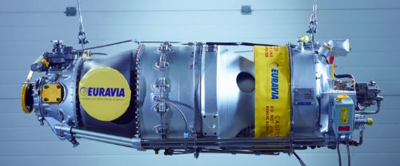
Hydrocarbon Turbine
Pratt & Whitney PT6A-11AG turboprop engine
Optimized for cruise
Most efficient RPM can be set for the cruise speed
Reliable, durable, high power-to-weight ratio
Its high power-to-weight ratio would make it well suited to provide backup power in the event of electrical system failure
Turboprop engine can be modified to run alternative fuels, such as biofuel and hydrogen
Notes:
2. This is because there is no need to optimize it for takeoff or climb, the only worry we have is the cruise condition.

Slide 6
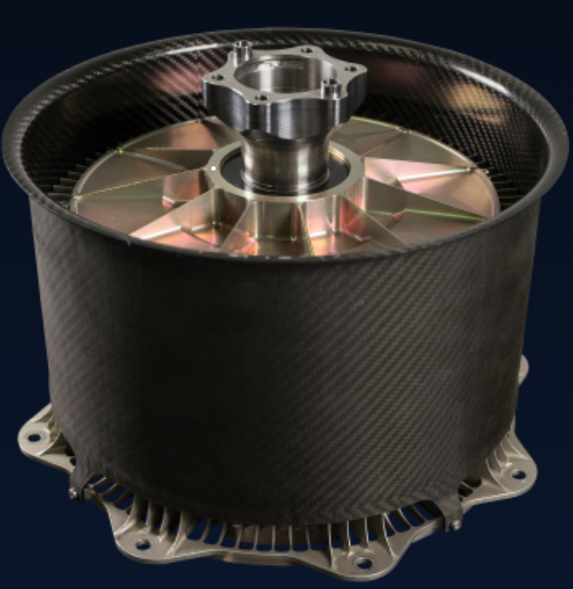
Electric motors
ENGINeUS™ Aircraft Electric Motor
Benefits:
Reduced noise pollution
Greater cargo capacity
Improved efficiency (reduce aircraft’s fuel consumption)
Thrust is uniformly distributed
Downsides:
Need for stronger, heavier spars or wing material
Higher upfront costs
Potential for decreased performance in certain weather conditions
Limited availability of charging infrastructure

Slide 7
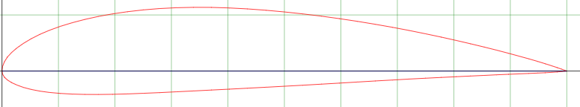
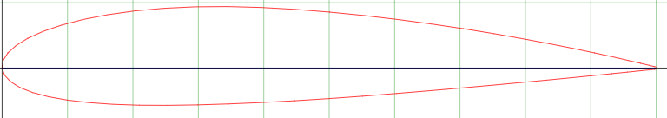
Wing Characteristics
Root Chord: 6ft NACA4415
Tip Chord: 2.5ft NACA2415
L/D: 28 (just wing)
Length: 35ft
Wing area: 17.05m^2
Wetted area: 20.14m^2
Taper: 0.42
NACA4415
NACA2415
Taper can help reduce drag
Higher taper provides more roll control, allowing for better maneuverability
Improve stability during turns or turbulent conditions

Slide 8
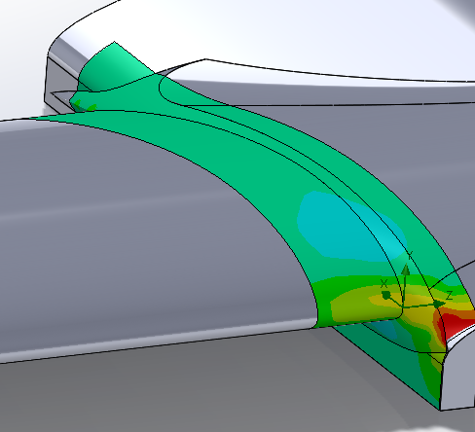
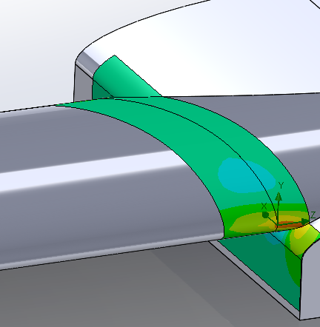
Pressure Comparisons
With Fillet Without Fillet
Better attachment of airflow onto wing surface, resulting in increased lift and reduced drag
Reduced turbulence and vortex
High pressure area near fuselage - wing junction
Separation of airflow from winged surface, resulting in turbulence and drag

Slide 9
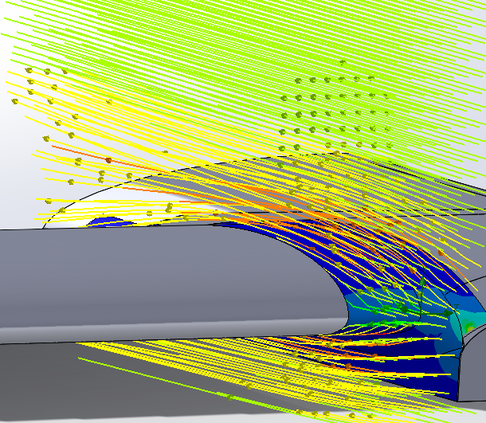
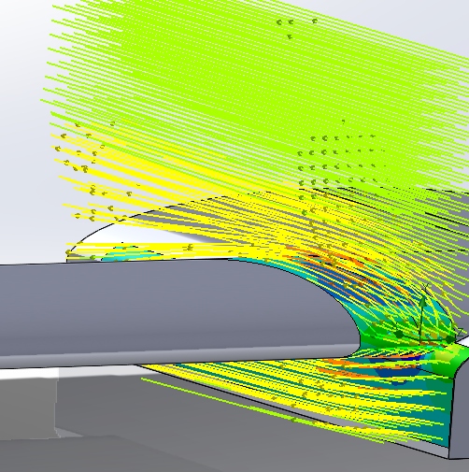
Flow Visualization
With Fillet
Without Fillet
* Darker lines over the wing by the root indicates that there is a higher velocity over the wing, which results in an increased lift production when the fillet is present.
Notes:
Darker lines over the wing by the root suggest higher velocity over the wing meaning higher lift produced with the fillet

Slide 10
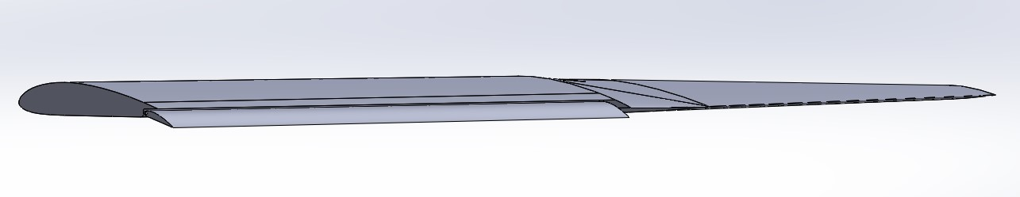
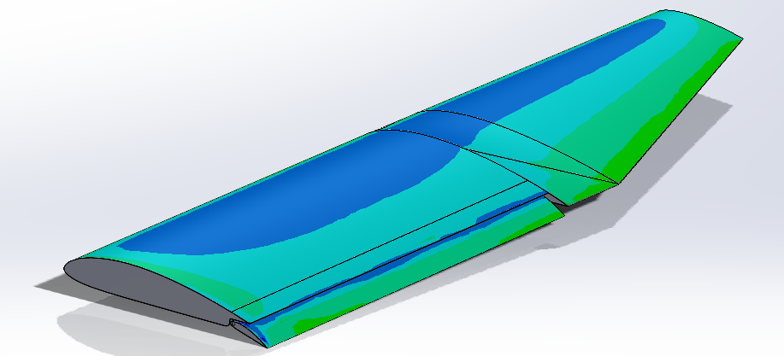
Wing With Flaps

Slide 11
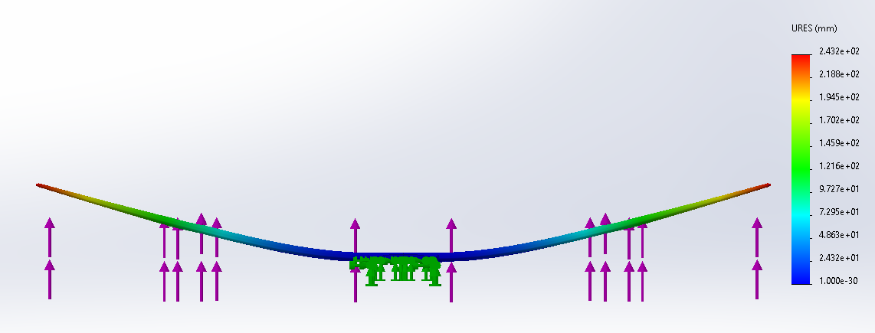
Wing Bending From Lift Force
Notes:
Aluminum 6061-T6 (Normal aviation alloy of aluminum) strong and lightweight

Slide 12
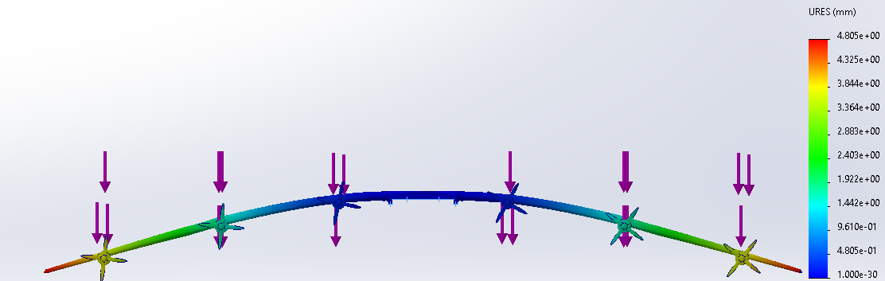
Displacement From Motor Weight
Notes:
Assuming weight of each motor, propeller and shroud is 200lbs

Slide 13
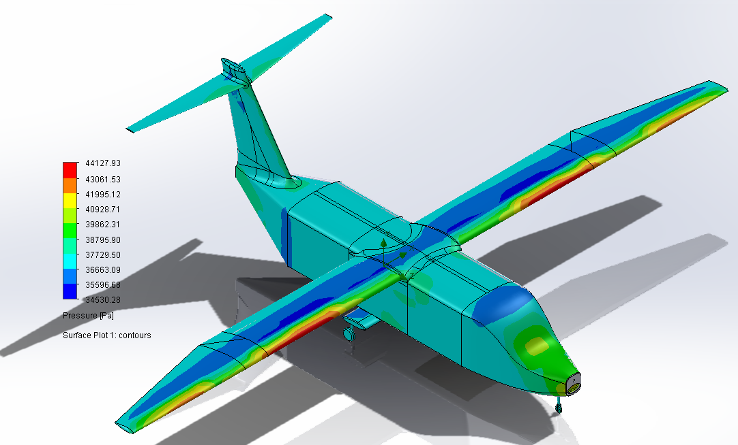
Full Plane pressure

Slide 14
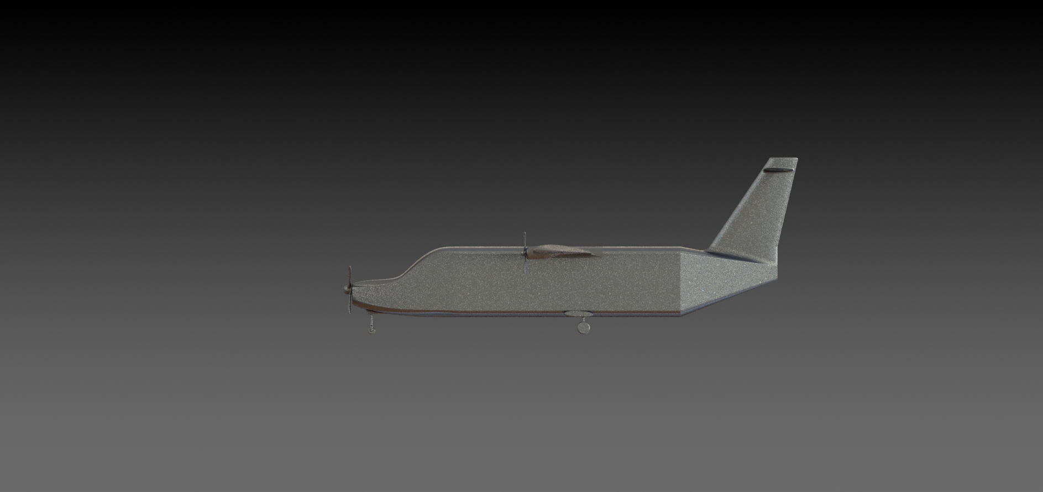
Location of Interior Components
Payload (Cargo) similar to Cessna SkyCourier (fuselage)
Fuel (Jet A) stored in wings
Battery packs bottom of fuselage
PT6 Turboprop in noise
PT6 Turboprop
Fuel tank
Battery packs

Slide 15
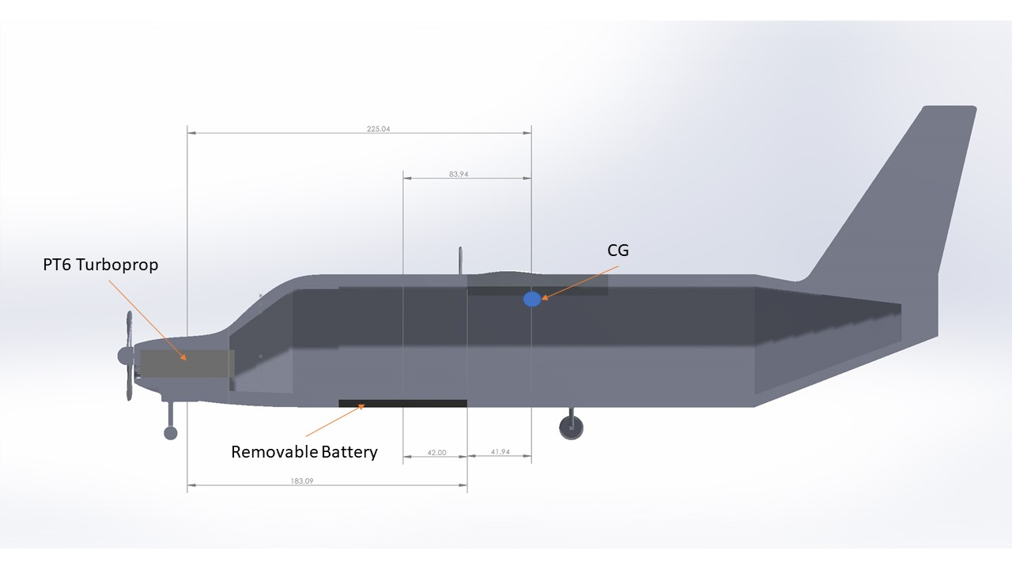
Weight and Balance
Total max weight = 8391.46 kg
Aluminum wings are lightweight & have strong enough tensile strength
Cargo weight = 3500 lbs (~1588 kg)
Motors on wings
Batteries on bottom
Fuel tanks on wings

